Slide 1
NATIONAL UNIVERSITY OF HO CHI MINH CITY
UNIVERSITY OF INFORMATION TECHNOLOGY
FACULTY OF COMPUTER ENGINEERING
LECTURE
Subject:
VERILOG
Hardware Description Language
Chapter6: Behavioral Model
- Combinational logic
- Sequential logic
Lecturer: Lam Duc Khai

Slide 2
Agenda
1. Chapter 1: Introduction ( Week1)
2. Chapter 2: Fundamental concepts (Week1)
3. Chapter 3: Modules and hierarchical structure (Week2)
4. Chapter 4: Primitive Gates – Switches – User defined primitives (Week2)
5. Chapter 5: Structural model – Combination circuit & Sequential circuit (Week3)
6. Chapter 6: Behavioral model – Combination circuit & Sequential circuit (Week4 & Week5)
7. Chapter 7: Tasks and Functions (Week6)
8. Chapter 8: State machines (Week6)
9. Chaper 9: Testbench and verification (Week7)

Slide 3
Agenda
Combinational circuit
What and why behavior model
Operators
Behavior model in combinational circuit
  Continuous assignment (like Dataflow)
  Procedural assignment
    Initial and Always blocks
    Blocking assignment
    Non-blocking assignment
    Conditional statement (if-else)
    Case statement
    Looping statement ( for, while )
    Block statement
  Combinational synthesis

Slide 4
Circuit design
Circuit Design
Combinational Circuit
Ex:
Multiplexer, Decoder,
Encoder, Adder, …
Sequential Circuit
Ex:
Latch, Flip-flop, Counter,
State machine, Synchronous,
Asynchronous,…

Slide 5
Combinational circuit
Circuit Design
Combinational Circuit
Already studied in Chapter 5
Will be studied in this Chapter
Structural model
(Primitive gates
Switches
User-defined gates)
Behavioral model
Continuous assignment
( assign keyword )
Procedural assignment
(Blocking assignment)
(initial statement
always statement
function statement
task statement)

Slide 6
Combinational Circuit
Outputs are functions of the current inputs
Logic without state variables
No clock involved
Examples
  multiplexers
  decoders
  encoders
  adders
inputs
Combinational
circuits
Outputs

Slide 7
Behavioral model : What & Why
What Behavioral model ?
  More like a procedure in a programming language, but NOT.
  Program describes input/output behavior of circuit, tell what you want to have happen, NOT what gates to connect to make it happen.
  Describe what a component does, not how it does it
  Many structural models could have same behavior
  E.g., different implementations of one Boolean function
  Synthesized into a circuit that has this behavior
  Result is only as good as the tools

Slide 8
Behavioral model : What & Why
Why Behavioral model ?
  Good for more abstract models of circuits
  Easier to write
  Simulates faster
  More flexible
  Provides sequencing
  A much easier way to write testbenches
  Verilog succeeded in part because it allowed both the model and the testbench to be described together

Slide 9
Operators
Arithmetic Operators
+, -, *, /, %
Relational Operators
<, <=, >, >=
Equality Operators
==, !=, ===, !==
Logical Operators
!, &&, ||
Bit-Wise Operators
~, &, |, ^, ~^
Unary Reduction
&, ~&, |, ~|, ^, ~^
Shift Operators
>>, <<
Conditional Operators
?:
Concatenations
{}
Notes:
a===b : a equal to b, including x and z
a!==b : a not equal to b, including x and z
For the case equality and case inequality operators(=== and !==), the comparison shall be done just as it is in the
procedural case statement (see 9.5). Bits that are x or z shall be included in the comparison and shall match for the
result to be considered equal. The result of these operators shall always be a known value, either 1 or 0.

Slide 10
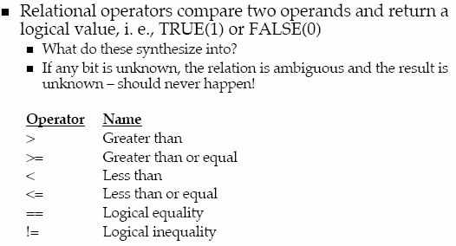
Operators
Relational Operators
Notes:
//let a = 4, b = 3, and...
//x = 4’b1010, y = 4’b1101,
//z = 4’b1xxz, m = 4’b1xxz, n = 4’b1xxx
a == b //evaluates to logical 0
x != y //evaluates to logical 1
x == z //evaluates to x
z === m //evaluates to logical 1
z === n //evaluates to logical 0
m !== n //evaluates to logical 1

Slide 11
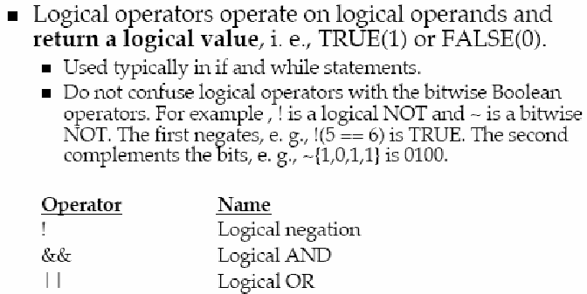
Operators
Logical Operators
Notes:
Logical operators evaluate to a 1 bit value
0 (false), 1 (true), or x (ambiguous)
Operands not equal to zero are equivalent to one
a = 1011; b = 0010, c = 0000
a && b = 1 since a#0, b#0 ➔ 1 && 1 = 1
a || b = 1 since a#0, b#0 ➔ 1 || 1 = 1
a && c = 0
a || c = 1
!a = 0
!c = 1

Slide 12
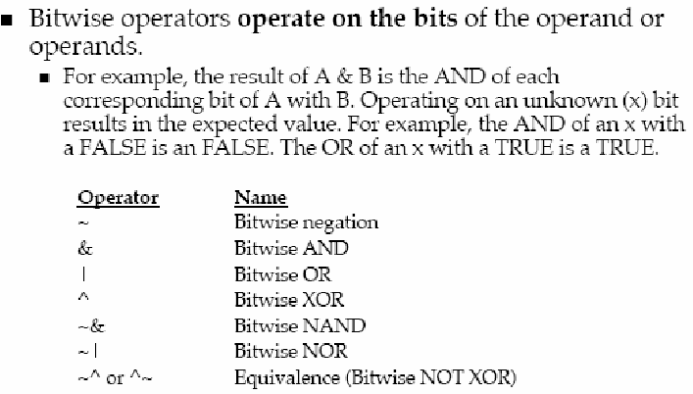
Operators
Bitwise Operators
Notes:
a = 1011; b = 0010
a | b = 1011
B & b = 0010

Slide 13
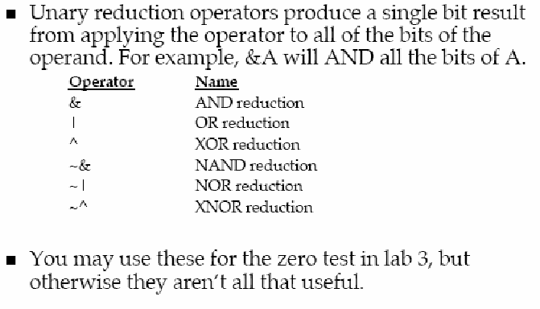
Operators
Unary Reduction Operators
Notes:
Unary reduction operators have only one operand
x = 4’b1010
&x //equivalent to 1 & 0 & 1 & 0. Results in 1’b0
|x //equivalent to 1 | 0 | 1 | 0. Results in 1’b1
^x //equivalent to 1 ^ 0 ^ 1 ^ 0. Results in 1’b0

Slide 14
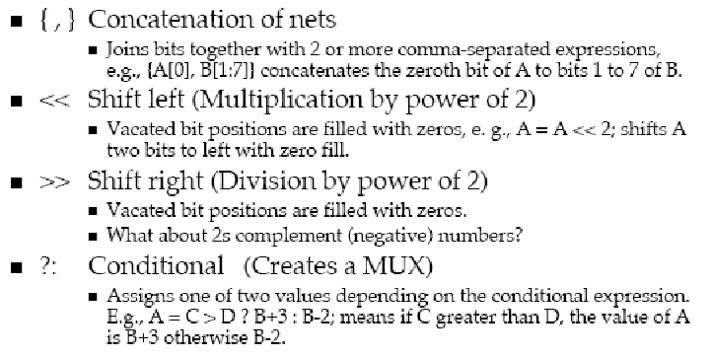
Operators
Miscellaneous Operators
Notes:
Concatenation operator
//let a = 1’b1, b = 2’b00, c = 2’b10, d = 3’b110
y = {b, c} // y is then 4’b0010
y = {a, b, c, d, 3’b001} // y is then 11’b10010110001
y = {a, b[0], c[1]} // y is then 3’b101
Shift Operator
let x = 4’b1100
y = x >> 1; // y is 4’b0110
y = x << 1; // y is 4’b1000
y = x << 2; // y is 4’b0000
Conditional Operator ?:
Conditional expression ? True expression : false expression
Replication Operator
//let a = 1’b1, b = 2’b00, c = 2’b10, d = 3’b110
y = { 4{a} } // y = 4’b1111
y = { 4{a}, 2{b} } // y = 8’b11110000
y = { 4{a}, 2{b}, c } // y = 8’b1111000010

Slide 15
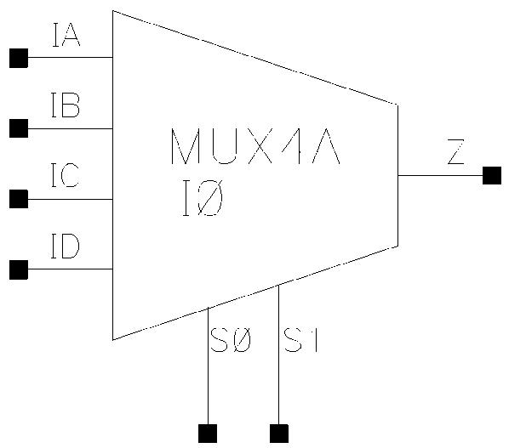
Operators
Examples
Logical, bit-wise and unary operators
  a = 1011; b = 0010
  logical bit-wise unary
  a || b = 1 a | b = 1011 |a = 1
  a && b = 1 a &b = 0010 &a = 0
Conditional operator
  assign z = ({s1,s0} == 2'b00) ? IA :
  ({s1,s0} == 2'b01) ? IB :
  ({s1,s0} == 2'b10) ? IC :
  ({s1,s0} == 2'b11) ? ID :
  1'bx ;
  assign s = (op == ADD) ? a+b : a-b ;
Notes:
Logical operators evaluate to a 1 bit value
0 (false), 1 (true), or x (ambiguous)
Operands not equal to zero are equivalent to one

Slide 16
Behavioral assignments
Two basic forms of behavioral assignments:
— Continuous assignment, which assigns values to nets.
— Procedural assignment, which assigns values to variables.
The significant difference between procedural assignments and continuous assignments:
— Continuous assignments drive nets and are evaluated and updated whenever an input operand changes value.
— Procedural assignments update the value of variables under the control of the procedural flow constructs that surround them.

Slide 17
Combinational logic -
Continuous assignment

Slide 18
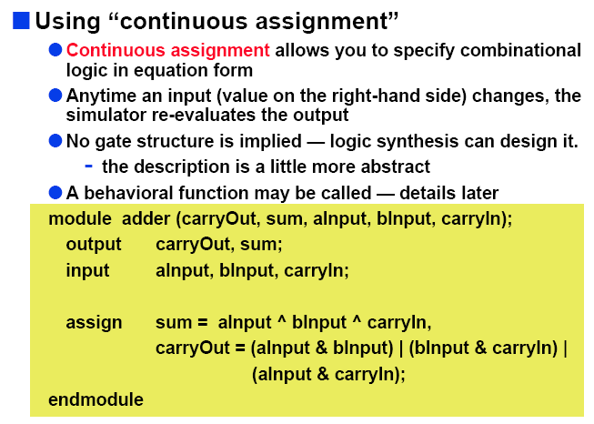
Continuous assignment
Using continuous assignment

Slide 19
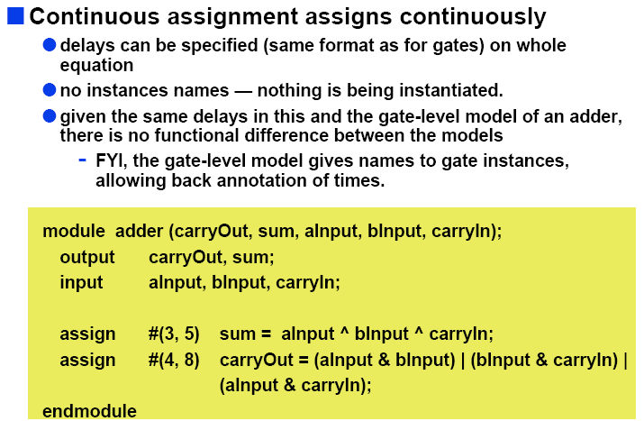
Continuous assignment
Using continuous assignment (cont’d)

Slide 20
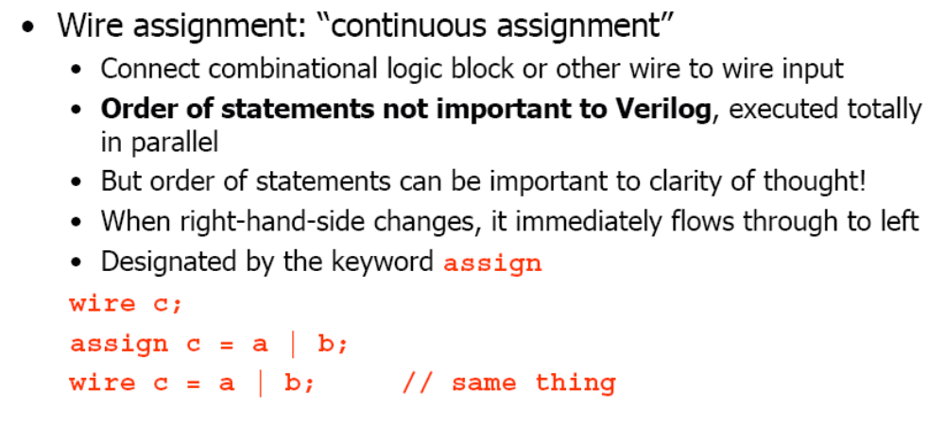
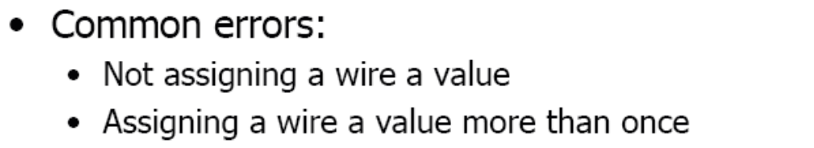
Continuous assignment
Using continuous assignment (cont’d)

Slide 21
Continuous assignment
Using continuous assignment (cont)
Drive values to a net
  assign out = a&b ; // and gate
  assign eq = (a==b) ; // comparator
  wire #10 inv = ~in ; // inverter with delay
  wire [7:0] c = a+b ; // 8-bit adder
Avoid logic loops
  assign a = b + a ;
  asynchronous design

Slide 22
Continuous assignment
Using continuous assignment (cont)
Target (LHS) is NEVER a reg variable
LHS must be a wire
Dataflow style
use of Boolean operators
(~ for bit-wise, ! for logical negation)
assign A = X | (Y & ~Z);
assign B[3:0] = 4'b01XX;
assign C[15:0] = 4'h00ff;
assign #3 {Cout, S[3:0]} = A[3:0] + B[3:0] + Cin;
bits can take on four values
(0, 1, X, Z)
variables can be n-bits wide
(MSB:LSB)
use of arithmetic operator
multiple assignment (concatenation)
delay of performing computation, only used by simulator, not synthesis

Slide 23

Continuous assignment
Using continuous assignment (cont)
We can create various logic by connecting gates with wire. These connection are done by using assign statement as below
assign aa_signal = bb_signal;
bb_signal
aa_signal
assign aa_signal = (bb_signal ^ cc_signal) & dd_signal;
bb_signal
cc_signal
aa_signal
dd_signal
assign aa_signal = (cc_ctl)?bb_signal:dd_signal;
Using conditional operator instead of if or case statement is recommended
bb_signal
cc_ctl
aa_signal
dd_signal

Slide 24
Continuous assignment
Using continuous assignment (cont’d)
By using this assignment, we can write an RTL code as below
module eor_and example(bb_sig, cc_sig, dd_sig, aa_sig);
input bb_sign, cc_sign, dd_sign;
output aa_sign;
wire bb_sign, cc_sign, dd_sign;
wire aa_sign;
wire sig_eor;
assign aa_sign = sig_eor & dd_sig;
assign sig_eor = bb_sig ^ cc_sig;
endmodule
eor_and_example
bb_sig
sig_eor
aa_sig
cc_sig
output
input
dd_sig

Slide 25
Continuous assignment
Using continuous assignment (cont’d)
By using this assignment, we can write an RTL code as below
module eor_and example(bb_sig, cc_sig, dd_sig, aa_sig);
input bb_sign, cc_sign, dd_sign;
output aa_sign;
wire bb_sign, cc_sign, dd_sign;
wire aa_sign;
wire sig_eor;
assign aa_sign = sig_eor & dd_sig;
assign sig_eor = bb_sig ^ cc_sig;
endmodule
Note: Because the assignment is done always, exchanging the written order of the lines if continuous assignment has no influence on the logic.
eor_and_example
bb_sig
sig_eor
aa_sig
cc_sig
output
input
dd_sig

Slide 26
Continuous assignment
Using continuous assignment (cont’d)
Question: What shall be the result of the following assignment?
(1) wire [3:0] y;
assign y[3:0] = -3;
(2) wire [3:0] y;
assign y[3:0] = 2’b10;
In your program, always make bit width of left-hand side and right-hand side equal
(3) wire [3:0] y;
assign y[3:0] = 6’b111000;
(4) wire [3:0] y;
assign y[3:0] = 1’b0;
(5) wire [3:0] y;
assign y[3:0] = 1’bx;
(6) wire [3:0] y;
assign y[3:0] = 4’bx;
(7) wire [3:0] y;
assign y[3:0] = 4’b1;

Slide 27
Continuous assignment
Using continuous assignment (cont’d)
A sample answer
(1) wire [3:0] y;
assign y[3:0] = -3;
y = 4’b1101
There may be tool dependency on these result.
(2) wire [3:0] y;
assign y[3:0] = 2’b10;
y = 4’b0010
(3) wire [3:0] y;
assign y[3:0] = 6’b111000;
y = 4’b1000
(4) wire [3:0] y;
assign y[3:0] = 1’b0;
y = 4’b0000
(5) wire [3:0] y;
assign y[3:0] = 1’bx;
y = 4’b000x
(6) wire [3:0] y;
assign y[3:0] = 4’bx;
y = 4’bxxxx
(7) wire [3:0] y;
assign y[3:0] = 4’b1;
y = 4’b0001

Slide 28
Continuous assignment
Using continuous assignment (cont’d)
Question: Check if the following statements are correct or not?
(1) wire [7:0] a, b;
assign b[7:0] = a[3:0] – 4’b0010;
b[7:0] = 8’b1111_1110 if a is 8’h00
In your program, always make bit width of left-hand side and right-hand side equal
(2) wire [7:0] a, b;
assign a[3:0] = b[7:0] – 4’b0100;
a[3:0] = 4’hC if b[7:0] is 8’h00
(3) wire [7:0] a, b;
assign b[7:0] = a[3:0] – 6’b110001;
b[7:0] = 8’b0000_1111 if a is 8’h00

Slide 29
Continuous assignment
Using continuous assignment (cont’d)
A sample answer
(1) wire [7:0] a, b;
assign b[7:0] = a[3:0] – 4’b0010;
b[7:0] = 8’b1111_1110 if a is 8’h00
Correct,
sign extended
(2) wire [7:0] a, b;
assign a[3:0] = b[7:0] – 4’b0100;
a[3:0] = 4’hC if b[7:0] is 8’h00
Correct
(3) wire [7:0] a, b;
assign b[7:0] = a[3:0] – 6’b11_0001;
b[7:0] = 8’b0000_1111 if a is 8’h00
Wrong,
b[7:0] is 8’b1100_1111
There may be tool dependency. Do not assume the above is true in the future

Slide 30
Continuous assignment
Using continuous assignment (cont’d)
Question: Write a Verilog RTL code for the gate diagram shown below.
(Compile the part.)
a
w3
y
w1
w4
b
wire a, b, c, y;
w2
c
assign y =

Slide 31
Continuous assignment
Using continuous assignment (cont’d)
a
w3
y
w1
w4
b
wire a, b, c, y;
wire w1, w2, w3, w4;
assign w1 = (~a) & b;
assign w2 = b | c;
assign w3 = ~(a & c);
assign w4 = w1 & w2;
assign y = w3 ^ w4;
w2
c
wire a, b, c, y;
wire w3, w4;
assign w3 = ~(a & c);
assign w4 = ((~a) & b) & (b | c);
assign y = w3 ^ w4;
A sample answer
Implicit wire declaration and implicit continuous assignment
wire a, b, c, y;
assign y = ~(a & c) ^ ((~a) & b) & (b | c);

Slide 32
Continuous assignment
Example1
module aOrNotbOrc(d, a, b, c);
output d;
input a, b, c;
wire p, q;
assign q = ~b;
assign p = a || q;
assign d = p || c;
endmodule
Continuous assignment statements: any change in
the RHS causes instantaneous update of the wire
on the LHS, unless there is a programmed delay.

Slide 33
Continuous assignment
Example2
module mux4_1(out, in1, in2, in3, in4, cntrl1, cntrl2);
output out;
input in1, in2, in3, in4, cntrl1, cntrl2;
assign out = cntrl1 ? (cntrl2 ? in4 : in3) : (cntrl2 ? in2 : in1);
endmodule
module mux4_1(out, in1, in2, in3 ,in4, cntrl1, cntrl2);
output out;
input in1, in2, in3, in4, cntrl1, cntrl2;
assign out = (in1 & ~cntrl1 & ~cntrl2) |
(in2 & ~cntrl1 & cntrl2) |
(in3 & cntrl1 & ~cntrl2) |
(in4 & cntrl1 & cntrl2);
endmodule
  module mux4_1 (out, in1, in2, in3, in4, cntrl) ;
  output out ;
  input in0,in1,in2,in3 ;
  input [1:0] cntrl;
  assign out = (cntrl == 2'b00) ? in0 :
  (cntrl == 2'b01) ? in1 :
  (cntrl == 2'b10) ? in2 :
  (cntrl == 2'b11) ? in3 :
  1'bx ;
  endmodule

Slide 34
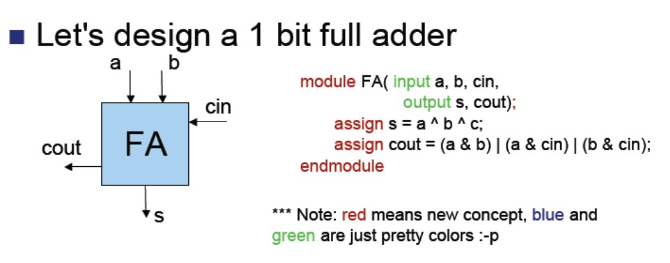
Continuous assignment
Example3
  module adder(c,s,a,b) ;
  output c ;
  output [7:0] s ;
  input [7:0] a,b ;
  assign {c,s} = a + b ;
  endmodule

Slide 35
Continuous assignment
Example4
module comparator (result, A, B, greaterNotLess);
parameter width = 8;
parameter delay = 1;
input [width-1:0] A, B; // comparands
input greaterNotLess; // 1 - greater, 0 - less than
output result; // 1 if true, 0 if false
assign #delay result = greaterNotLess ? (A > B) : (A < B);
endmodule
Comparator makes the comparison A ? B
where ? Is determined by the input
greaterNotLess and returns true(1) or false(0).
Parameters that may be set
when the module is instantiated.

Slide 36
Continuous assignment
Example5
module Compare1 (A, B, Equal, Alarger, Blarger);
input A, B;
output Equal, Alarger, Blarger;
assign Equal = (A & B) | (~A & ~B);
assign Alarger = (A & ~B);
assign Blarger = (~A & B);
endmodule

Slide 37
Continuous assignment
Example5 (Cont’d)
// Make a 4-bit comparator from 4 1-bit comparators
module Compare4(A4, B4, Equal, Alarger, Blarger);
input [3:0] A4, B4;
output Equal, Alarger, Blarger;
wire e0, e1, e2, e3, Al0, Al1, Al2, Al3, B10, Bl1, Bl2, Bl3;
Compare1 cp0(A4[0], B4[0], e0, Al0, Bl0);
Compare1 cp1(A4[1], B4[1], e1, Al1, Bl1);
Compare1 cp2(A4[2], B4[2], e2, Al2, Bl2);
Compare1 cp3(A4[3], B4[3], e3, Al3, Bl3);
assign Equal = (e0 & e1 & e2 & e3);
assign Alarger = (Al3 | (Al2 & e3) |
(Al1 & e3 & e2) |
(Al0 & e3 & e2 & e1));
assign Blarger = (~Alarger & ~Equal);
endmodule

Slide 38
Continuous Assignment
Summary
To describe much sophisticated logic easily, procedural assignment is available in Verilog RTL programming.
Always statement, function, initial statement, and task are available as procedural assignment. (See later)
Assignments applicable in those procedural assignments are different from the continuous assignments in the previous page. They are called procedural assignment.

Slide 39
Combinational logic -
Procedural assignment
(Blocking assignment)

Slide 40
Behavioral assignments (Reminder)
Two basic forms of behavioral assignments:
— Continuous assignment, which assigns values to nets.
— Procedural assignment, which assigns values to variables.
The significant difference between procedural assignments and continuous assignments:
— Continuous assignments drive nets and are evaluated and updated whenever an input operand changes value.
— Procedural assignments update the value of variables under the control of the procedural flow constructs that surround them.

Slide 41
Procedural Assignment
— Procedural assignments occur within procedures such as always, initial, task, and function structures.
— Being thought of as “triggered” assignments. The “event-triggered” occurs when the flow of execution in the simulation reaches an assignment within a procedure. Reaching the assignment can be controlled by conditional statements.
— Processes run until they delay for a period of time or wait for a triggering event

Slide 42
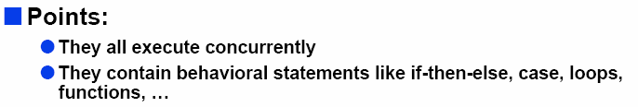

Initial and Always blocks
Basic components for behavioral modeling
initial
begin
… imperative statements …
end
Runs when simulation starts
Terminates when control reaches the end
Good for providing stimulus
always
begin
… imperative statements …
end
Runs when simulation starts
Restarts when control reaches the end
Good for modeling/specifying hardware

Slide 43
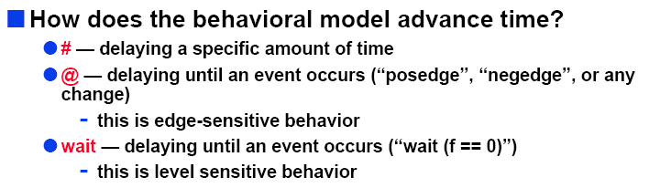
Initial and Always blocks

Slide 44
Procedural Assignment
Using procedural assignment
Inside an initial or always block:
Just like in C: RHS evaluated and assigned to LHS before next statement executes
RHS may contain wires and regs
  Two possible sources for data
LHS must be a reg
  Primitives or cont. assignment may set wire values

Slide 45
Procedural assignments
Using procedural assignment
Restriction for procedural assignment
 | LHS must be | RHS can be | Note
Procedural assignment | Register data type variable. | Any data type | Applicable only in procedural statements: initial, always, function, and task.
reg a;
a = ----;
wire a;
a = ----;

Slide 46
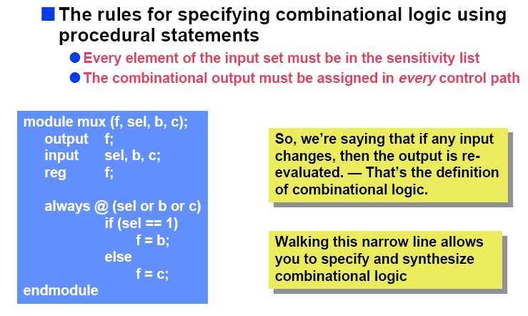
Procedural Assignment
Using procedural assignment

Slide 47
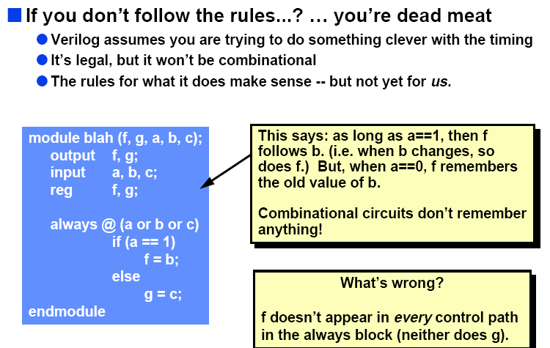
Procedural Assignment
Using procedural assignment

Slide 48
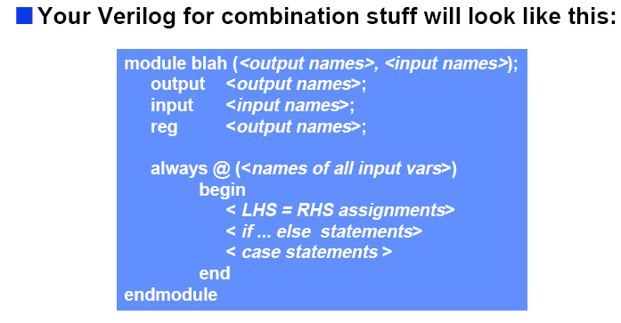
Procedural Assignment
Using procedural assignment

Slide 49
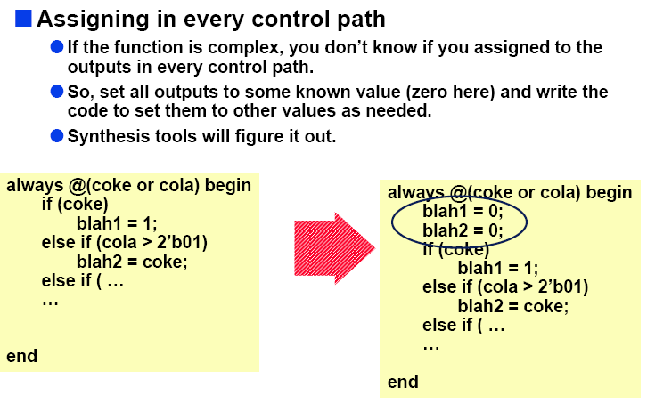
Procedural Assignment
Using procedural assignment

Slide 50
Procedural Assignment
The Verilog HDL contains two types of procedural assignment statements:
— Blocking procedural assignment statements generally used to described the combinational logic.
— Nonblocking procedural assignment statements generally used to described the sequential logic.

Slide 51
Procedural assignments
Blocking assignment vs Non-blocking assignment
Blocking procedural assignment
a_sig = b_sig;
Procedural assignment
Execution of the next line is blocked until this assignment is done.
Nonblocking procedural assignment
Assignment is done depending on procedure.
a_sig <= b_sig;
Execution of the next line is not blocked by this line
Only applicable in procedural statements: function, always, initial and task

Slide 52
Procedural assignments
Blocking assignment vs Non-blocking assignment
Blocking assignment =
  Regular assignment inside procedural block
  Assignment takes place immediately
  LHS must be a register
Nonblocking assignment <=
  Compute RHS
  Assignment takes place at end of block
  LHS must be a register
always
begin
A = B;
B = A;
end
A = B, B= B
always
begin
A <= B;
B <= A;
end
swap A and B

Slide 53
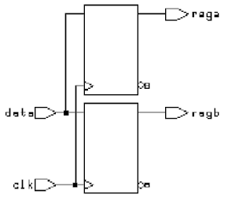
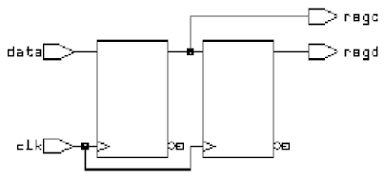
Procedural Assignment
Blocking assignment vs Non-blocking assignment
Blocking assignments
  always @(posedge clk) begin
    rega = data ;
    regb = rega ;
  end
Non-blocking assignments
  always @(posedge clk) begin
    regc <= data ;
    regd <= regc ;
  end

Slide 54
Procedural assignments
Blocking assignment vs Non-blocking assignment
In structured procedure, if there are more than one statement to execute, they must be grouped in one block. “begin end” and “fork join” are available.
However, use “begin end” for logics which must be synthesized.
The block defined by begin and end pair is called “sequential block”
begin
Statement are executed in the order they are written.
end

Slide 55
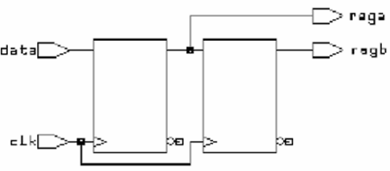
Procedural Assignment
Blocking assignment: order of statements will affect on
the synthesis process.
Blocking assignments
  always @(posedge clk) begin
    rega = data ;
    regb = rega ;
  end
Blocking assignments
  always @(posedge clk) begin
    regb = rega ;
    rega = data ;
  end
The same with non-blocking assignments

Slide 56
Procedural Assignment
Non-blocking assignment: order of statements won’t affect
on the synthesis process.
Non-blocking assignments
  always @(posedge clk) begin
    rega <= data ;
    regb <= rega ;
  end
Non-blocking assignments
  always @(posedge clk) begin
    regb <= rega ;
    rega <= data ;
  end

Slide 57
Procedural assignments
Blocking assignment
If no wk is given value outside this block, every time this block is executed because of change of a, their value change as below.
reg wk1, wk2, wk3, wk4, y;
begin
wk1 = a;
wk2 = wk1;
wk3 = wk2;
wk4 = wk3;
y = wk4;
end
(1)
a
a1
a2
a3
a4
a5
a6
(2)
a1
a2
a3
a4
a5
a6
This means from a to y, the connection is direct
wk1
(3)
wk2
a1
a2
a3
a4
a5
a6
wk3
a1
a2
a3
a4
a5
a6
wk4
a1
a2
a3
a4
a5
a6
y
a1
a2
a3
a4
a5
a6
Because execution of (3) is blocked by (2), (3)’s right-hand side is evaluated after the execution of (2). (2) is executed after (1). Therefore wk2 in (3) shall be a1 and wk3 becomes a1.
3rd time
2nd time
1st time
wk1
wk2
wk3
wk4
y
a

Slide 58
Procedural assignments
Blocking assignment
Blocking procedural assignment has order dependency. Check an example on the left if the sequential block is executed because of the change of a.
reg wk1, wk2, wk3, wk4, y;
begin
y = wk4;
wk4 = wk3;
wk3 = wk2;
wk2 = wk1;
wk1 = a;
end
(1)
a
a1
a2
a3
a4
a5
a6
(2)
This result is same to that of nonblocking assignment.
(3)
wk1
a1
a2
a3
a4
a5
a6
(4)
wk2
x
a1
a2
a3
a4
a5
wk3
x
x
a1
a2
a3
a4
wk4
x
x
x
a1
a2
a3
y
x
x
x
x
a1
a2
3rd time
2nd time
When (1) is executed wk4 is not given a value. When (3) is executed wk2 is not given a value yet, therefore wk3 becomes x
1st time
wk1
wk2
wk3
wk4
y
a
an element to keep the previous value

Slide 59
Procedural assignments
Blocking assignment
Because assignment is done in serial in case of blocking procedural assignment, exchanging the order of statements will have large influence over the result.
begin
b = d | e;
a = b & c;
end
d
b
If the sequential block on the left is executed because of the change of c, d or e, then the results are different depending on the order of those two statements
e
a
c
begin
a = b & c;
b = d | e;
end
d
b
e
a
c
latch
You must be very careful to write statements which have mutual dependency like these two sentences.

Slide 60
A Flawed Shift Register:
Procedural assignments
Blocking assignment
This doesn’t work as you’d expect as a shift register:
reg d1, d2, d3, d4;
always @(posedge clk) d2 = d1;
always @(posedge clk) d3 = d2;
always @(posedge clk) d4 = d3;
What is synthesized ???

Slide 61
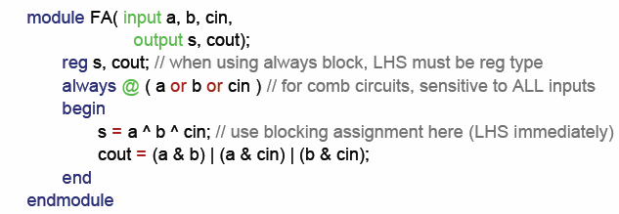
Procedural assignments
Blocking assignment
- Example1:

Slide 62
Procedural assignments
Blocking assignment
- Example2:
in
A
module shifter (in, A,B,C,clk);
input in, clk;
output A,B,C;
reg A, B, C;
always @ (posedge clk) begin
A = in;
B = A;
C = B;
end
endmodule
B
C
clk
Variable becomes a storage element if its value is preserved (carried forward in time) despite changes in variables the produce it.
Not whether it is declared as a wire or a reg!

Slide 63
Procedural Assignment
Non-blocking assignment: order of statements won’t affect
on the synthesis process.
Non-blocking assignments
  always @(posedge clk) begin
    rega <= data ;
    regb <= rega ;
  end
Non-blocking assignments
  always @(posedge clk) begin
    regb <= rega ;
    rega <= data ;
  end

Slide 64
Procedural assignments
Non-blocking assignment
If no wk is given value outside this block, every time this block is executed because of change of a, their value change as below.
reg wk1, wk2, wk3, wk4, y;
begin
wk1 <= a;
wk2 <= wk1;
wk3 <= wk2;
wk4 <= wk3;
y <= wk4;
end
(1)
a
a1
a2
a3
a4
a5
a6
(2)
a1
a2
a3
a4
a5
a6
This simulation result shows that some elements are expected as shown below
wk1
(3)
wk2
x
a1
a2
a3
a4
a5
wk3
x
x
a1
a2
a3
a4
wk4
x
x
x
a1
a2
a3
y
x
x
x
x
a1
a2
Because execution of (3) is not blocked by (2) nor (1), (3)’s right-hand side is evaluated before the execution of (2). And the evaluated value shall be x. Therefor wk3 becomes unknown (x).
3rd time
Those element are called latch or flip-flop.
2nd time
1st time
wk1
wk2
wk3
wk4
y
a
an element to keep the previous value

Slide 65
Procedural assignments
Non-blocking assignment
In case of nonblocking procedural assignment, there is less order dependency. Because it does not block of execution of the next sentences.
sequence / order dependency
reg wk1, wk2, wk3, wk4, y;
begin
y <= wk4;
wk4 <= wk3;
wk3 <= wk2;
wk2 <= wk1;
wk1 <= a;
end
Depending on your coding, there may still be some dependency. You have to understand how the assignment works.
Nonblocking procedural assignment does not block the execution of the next sentences. If the sequential block on the left is executed because of change of a, the result is same to the previous page.
The order of sentences is completely inverted from the example on the previous page
wk1
wk2
wk3
wk4
y
a
an element to keep the previous value

Slide 66
Non-blocking Assignments
Procedural assignments
Nonblocking rule:
RHS evaluated when assignment runs
This version does work as shift register:
reg d1, d2, d3, d4;
always @(posedge clk) d2 <= d1;
always @(posedge clk) d3 <= d2;
always @(posedge clk) d4 <= d3;
LHS updated only after all events for the current instant have run

Slide 67
Non-blocking Assignments
Procedural assignments
- Example1
module shifter (in, A,B,C,clk);
input in, clk;
output A,B,C;
reg A, B, C;
always @ (posedge clk) begin
B <= A;
A <= in;
C <= B;
end
endmodule
in
A
B
C
clk
Non-blocking: all statements interpreted in parallel
  Everything on the RHS evaluated,
  Then all assignments performed

Slide 68
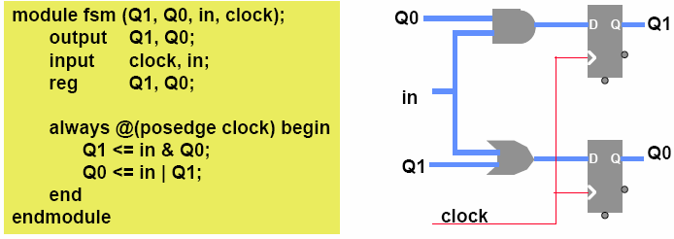
Non-blocking Assignments
Procedural assignments
- Example2

Slide 69
Procedural assignments
Synchronous clear
  module d_ff (q,d,clk,clr_) ;
  output q ;
  input d,clk,clr_ ;
  reg q ;
  always @ (posedge clk)
  if (~clr_)
  q = 0 ;
  else q = d ;
  endmodule
Asynchronous clear
always @ (posedge clk or negedge clr_)
  if (~clr_) q = 0 ;
  else q = d ;

Slide 70
Procedural assignments
  module register (q,d,clk,clr_, set_) ;
  output [7:0] q ;
  input [7:0] d ;
  input clk,clr_, set_ ;
  reg [7:0] q ;
  always @ (posedge clk or negedge clr_ or negedge set_)
  if (~clr_)
  q = 0 ;
  else if (~set_)
  q = 8’b1111_1111 ;
  else
  q = d ;
  endmodule

Slide 71
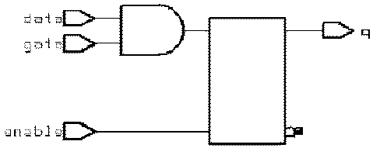
Procedural assignments
D latch
  always @ (enable or data)
  if (enable)
  q = data ;
D latch with gated asynchronous data
  always @ (enable or data or gate)
  if (enable)
  q = data & gate ;

Slide 72
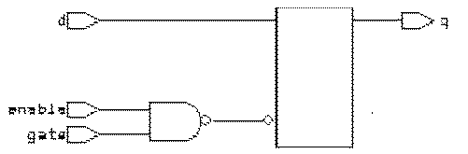
Procedural assignments
D latch with gated ‘enable’
  always @ (enable or d or gate)
  if (enable & gate)
  q = d ;
D latch with asynchronous reset
  always @ (reset or data or gate)
  if (reset)
  q = 1’b0
  else if(enable)
  q = data ;

Slide 73
Procedural assignments
  module shifter (so,si,d,clk,ld_,clr_) ;
  output so ;
  input [7:0] d ;
  input si,clk,ld_,clr_ ; // asynchronous clear and synchronous load
  reg [7:0] q ;
  assign so = q[7] ;
  always @ (posedge clk or negedge clr_)
  if (~clr_)
  q = 0 ;
  else if (~ld_)
  q = d ;
  else
  q[7:0] = {q[6:0],si} ; (q[7:0] <= {q[6:0],si} ; q[0:7] <= {q[6:0],si}) ?
  endmodule
  endmodule
ld_
d
si
shifter
so
clk

Slide 74
Procedural assignments
  module bcd_counter(count,ripple_out,clr,clk) ;
  output [3:0] count ;
  output ripple_out ;
  reg [3:0] count ;
  input clr,clk ;
  wire ripple_out = (count == 4'b1001) ? 0:1 ; // combinational
  always @ (posedge clk or posedge clr) // combinational + sequential
  if (clr) ;
  count = 0 ;
  else if (count == 4'b1001)
  count = 0 ;
  else
  count = count + 1 ;
  endmodule

Slide 75
Procedural assignments
  module memory (data, addr, read, write);
  input read, write;
  input [4:0] addr;
  inout [7:0] data;
  reg [7:0] data_reg;
  reg [7:0] memory [0:8'hff];
  parameter load_file = "cput1.txt";
  assign data = (read) ? memory [addr] : 8'hz;
  always @ (posedge write)
  memory[addr] = data;
  initial
  $readmemb (load_file, memory);
  endmodule

Slide 76
Verilog Coding Rules
Coding rules eliminate strange simulation behavior
  When modeling sequential logic, use nonblocking assignments
  When modeling combinational logic with always block, use blocking assignments. Make sure all RHS variables in block appear in @ expression
  Otherwise, use nonblocking procedural assignment if order dependency is not needed.
  Basically avoid order dependent code.
  However if order dependency is needed, use blocking procedural assignment.

Slide 77
Verilog Coding Rules
  If you mix sequential and combinational logic within the same always block use nonblocking assignments
  Don’t mix blocking and nonblocking assignments in the same always block
  Don’t make assignments to same variable from more than one always block
  Don’t make assignments using #0 delays

Slide 78
Synthesizable coding rules
Always keep in mind what sort of implementation your design could map to. If you don’t know, chances are synthesis doesn’t either.
  No case statements without default case
  No if statements without an else case
  If you assign to a net in one case it must be assigned to in all cases (no implicit storage)
No loops
No initial blocks
Limited operators
  + and – are the only arithmetic operators allowed
  Try to avoid relational operators (>, ==) in favor of simpler logic
Use assign statements when possible

Slide 79
Statements
Imperative statement
1. If statement
if (select == 1) y = a;
else y = b;
case (op)
2’b00: y = a + b;
2’b01: y = a – b;
2’b10: y = a ^ b;
default: y = ‘hxxxx;
endcase
2. Case statement

Slide 80
For Loops
Statements
A increasing sequence of values on an output
reg [3:0] i, output;
for ( i = 0 ; i <= 15 ; i = i + 1 ) begin
output = i;
#10;
end

Slide 81
While Loops
Statements
A increasing sequence of values on an output
reg [3:0] i, output;
i = 0;
while (I <= 15) begin
output = i;
#10 i = i + 1;
end

Slide 82
END

